Slide 1

CTR 10201
Champion: Jeff Creek
Asphaltene Deposition Simulator
ADEPT
Anju Kurup, Walter Chapman
Department of Chemical & Biomolecular Engineering, Rice University
Jill Buckley, Tianguang Fan
Jeff Creek, Jianxin Wang, Hari Subramani
PRRC, New Mexico Tech
Chevron ETC
Houston, TX, March 11, 2013

Slide 2

Content
Background
Simulator Structure & Protocol
Deposition Module
Scaling of deposition kinetics
Application of ADEPT to field cases
Variation of ADEPT
Summary

Slide 3


Project Strategy
Asphaltene flow assurance issues
Phase behavior (temperature, pressure, and composition)
Precipitation probability
Capillary / OSDC deposition tests
Deposition probability
Improved operating practices & risk mgt.
Deposition – Location, magnitude & growth rate

Slide 4
Simulator Structure
Experimental & Field Data
Translator
VLXE / Multiflash
Oil & Asphaltene Characterization
P & T
Thermodynamic Modeling Module
Asphaltene Solubility
CA*
Flow rate & geometry
Deposition Simulator
Asphaltene deposition profile & thickness
Precipitation, Aggregation & Deposition Rates
Experimental & Field Data

Slide 5
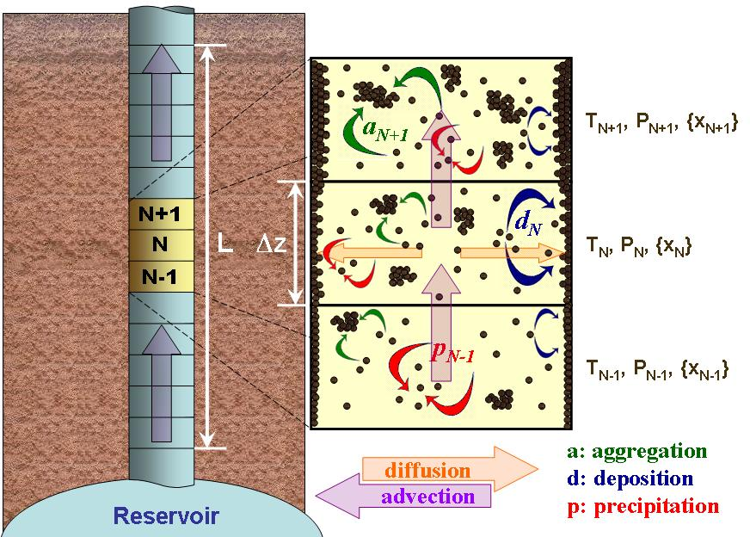
Wellbore Deposition Simulator
Lower
onset
Bubble
point
Precipitation zone
Onset
point

Slide 6
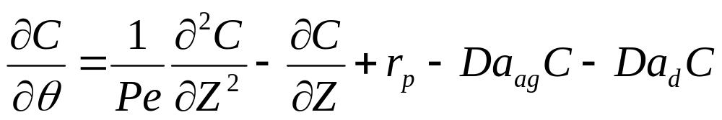
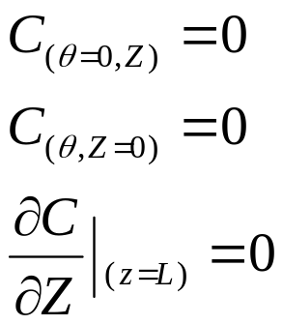
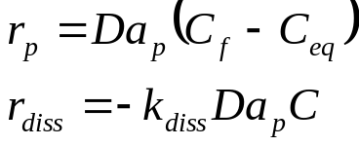
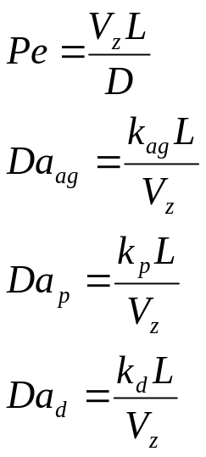
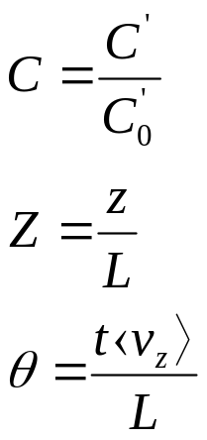
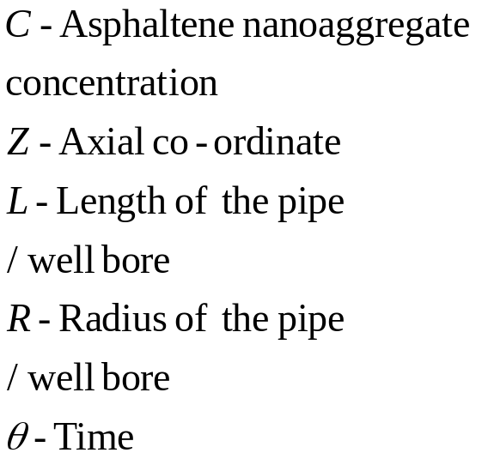
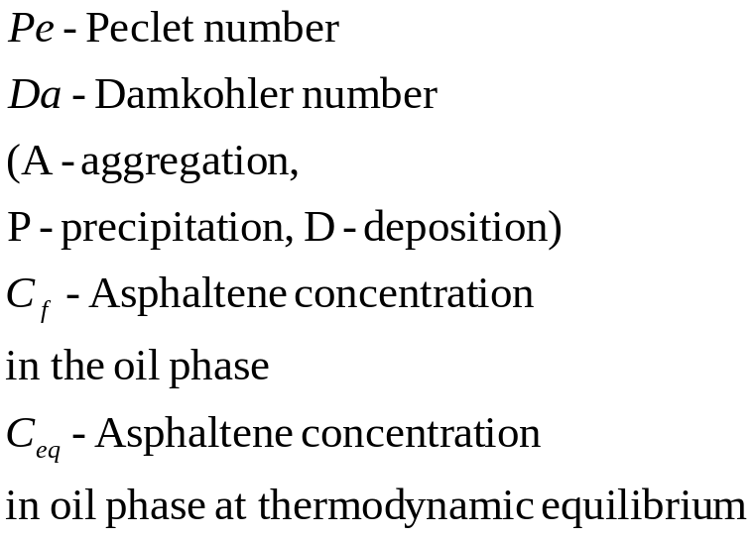
Mathematical model
Asph. Diss. Zone
Initial and boundary condition
Precipitation and dissolution kinetics
Asph. prec. Zone
When C_{f} < Ceq
Dimensionless parameters
Notes:
This is the axial dispersion model and these are the initial and boundary condition and dimensionless parameters. Another aspect we have introduced in this model is the presence of both precipitation and dissolution kinetics which happens typically in a well bore. As the oil flows up at certain temperature and pressure conditions it starts precipitating out. The bubble point is somewhere around here and after this point due to the release of the lighter components oil becomes a better solvent for asphaltene and therefore the precipitated asphaltenes can now dissolve back which we are incorporating through these kinetics.

Slide 7
Simulator Application Protocol
Thermodynamic model - live oil
Live oil composition, SARA
Density of live oil, STO
Bubble pressures, Onset pressures
Deposition Simulator
Precipitation & aggregation rates – Lab-scale kinetic measurements (NMT, other fractional precipitation results published in literature (Yarranton et al., 2004).
Deposition rate – Lab-scale deposition expts (NMT).
Scaling of kinetic parameters

Slide 8
Deposit build up rates
Scaling of Kd (deposition constant)
HM – 0.6 in in ~ 25 days = 7 E-7 cm/s
  20 – 25 % well head pressure in 15 – 20 days = 2E-7 cm/s
Kuwait well 0.5 in in ~ 2 months = 2.5 E-7 cm/s
Capillary test 1: (low flow rate thinner pipe) = 8.8E-8 cm/s
Capillary test 2: (high flow rate thicker pipe) = 1.3E-7 cm/s
Brosetta et al., 2000 = 0.75 – 4 mu/hr = 1E-7 cm/s
Re ranging > 100000 to < 1.
Assumption: The laminar layer near the wall governs the deposition kinetics.

Slide 9

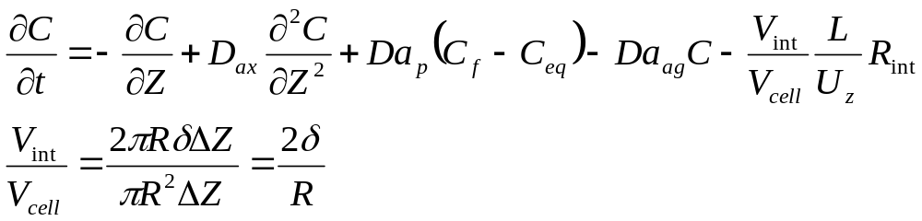
Proposed modification: Deposition simulator model
Turbulent flow in well bores / pipelines – Turbulent core & boundary layer near wall with laminar flow conditions
Capillary pipe deposition kinetics – representative of deposition kinetics in this boundary layer.
C
C_{int}
δ
Mass balance in each axial segment (del z, V_{cell})
V_{int} – Volume of boundary layer
R_{int} – Asphaltene removal rate due to deposition

Slide 10
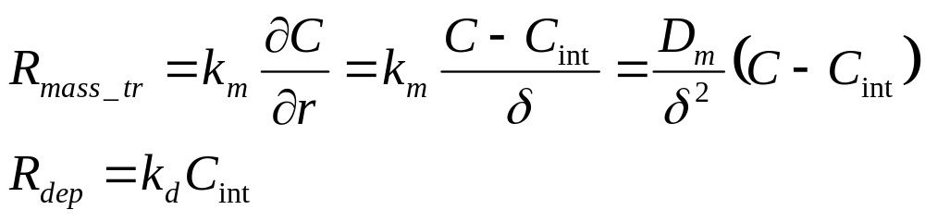
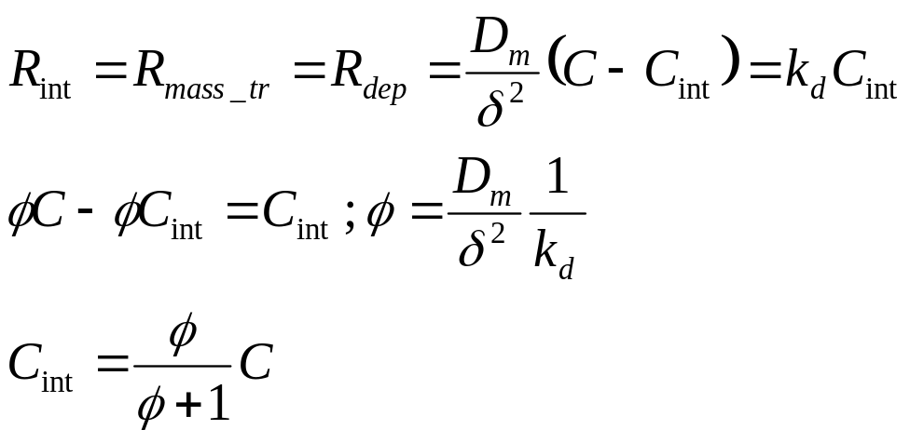
Proposed modification: Deposition simulator model
Mass balance in the boundary / interfacial layer
Mass transfer from bulk & Removal of Asphaltene due to deposition
C
C_{int}
At Steady State
δ

Slide 11
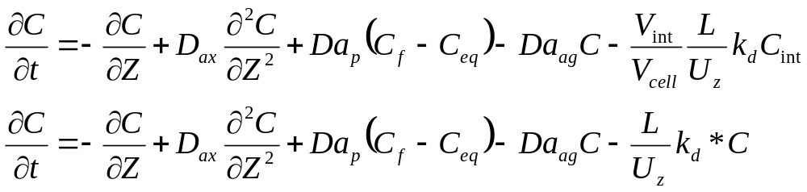
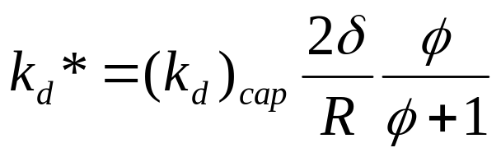
Proposed modification: Deposition simulator model
Mass balance in each axial segment (del z, V_{cell})
Relates turbulent scale deposition constant to capillary scale deposition constant

Slide 12
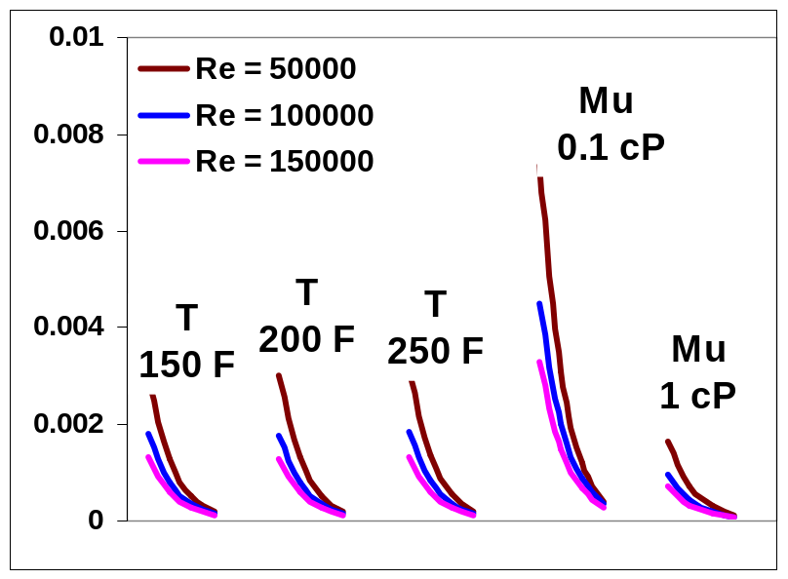
Scaling Factor Sensitivity
Kd_{cap} = 0.0131 /sec
Re numbers, Temperature, Viscosity
Increase in Re decreases deposition.
Temperature – no significant effect.
Decrease in viscosity increases deposition.

Slide 13
ADEPT – Field cases

Slide 14
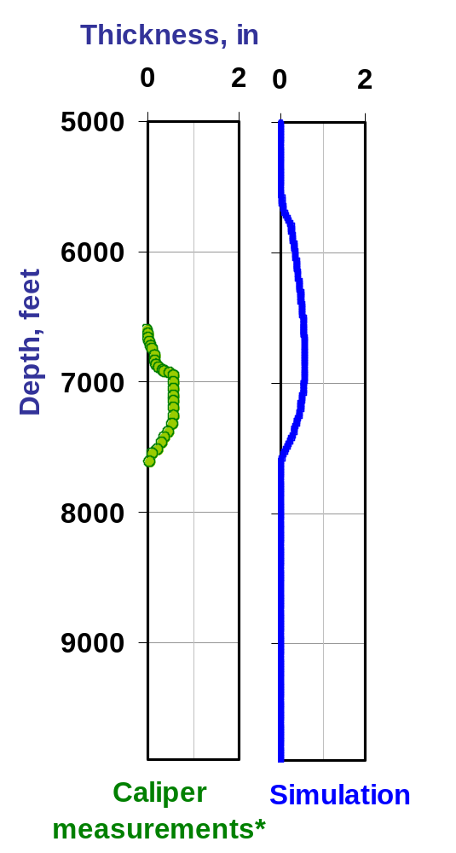
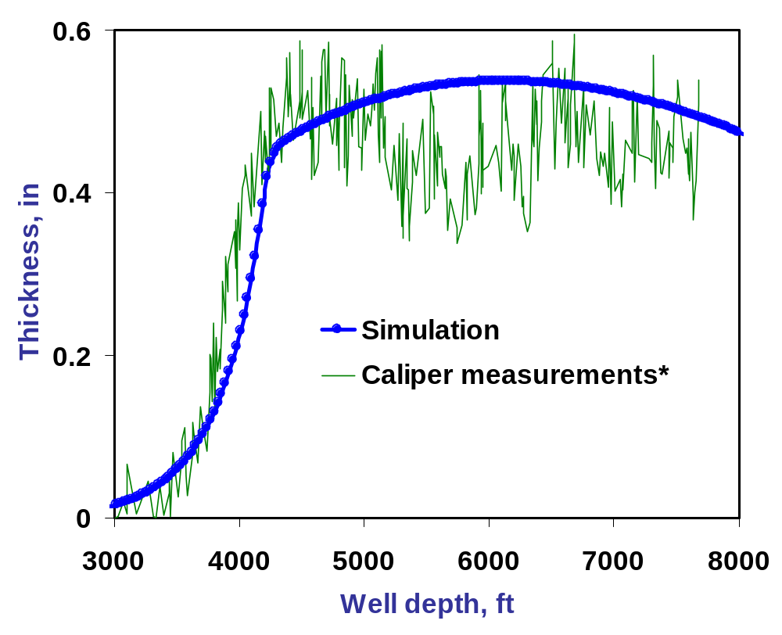
Field case
Marrat field
Hassi Messaoud field

Slide 15
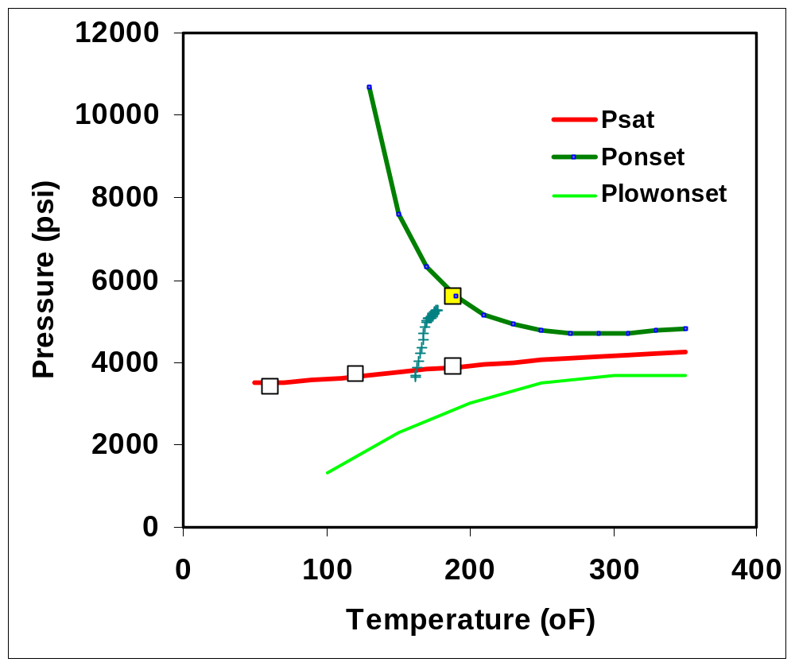
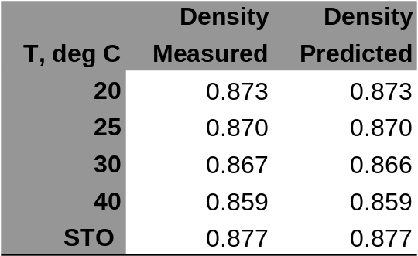
Asphaltene precipitation envelope with PC SAFT
Density predictions with PC SAFT vs measured
Yellow data point – Measured asphaltene onset
White data points – Measured saturation pressures
Green data points – P , T profile
PC SAFT parameter estimation performed using the previously established protocol (Gonzalez et al.).
The thermodynamic model was benchmarked against the data available – Psat , Ponset

Slide 16
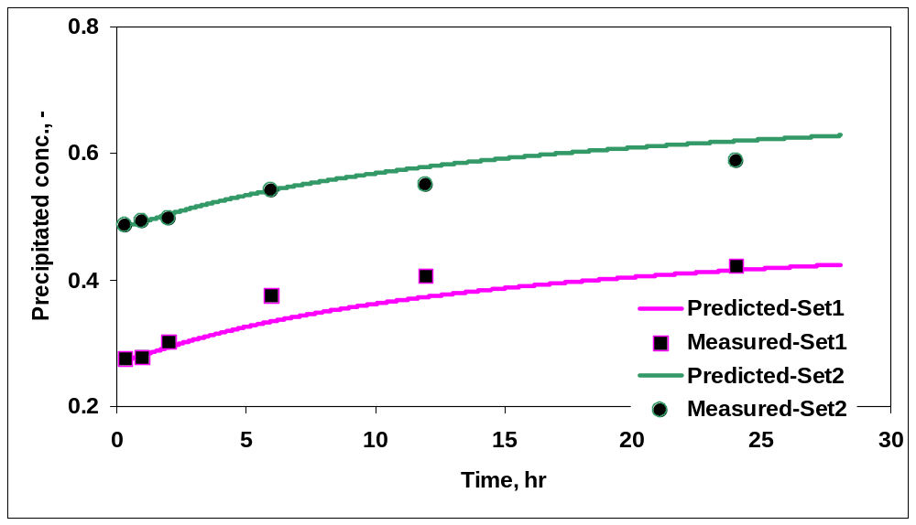
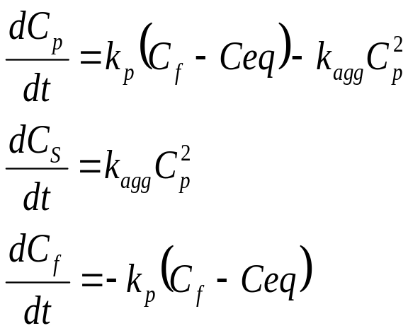
Kinetic parameter estimation
Determination of Kp & Kag
Kinetic experiments with C7 - NMT
Kp = 1.3E-3, Kag = 7.3E-5 / sec

Slide 17
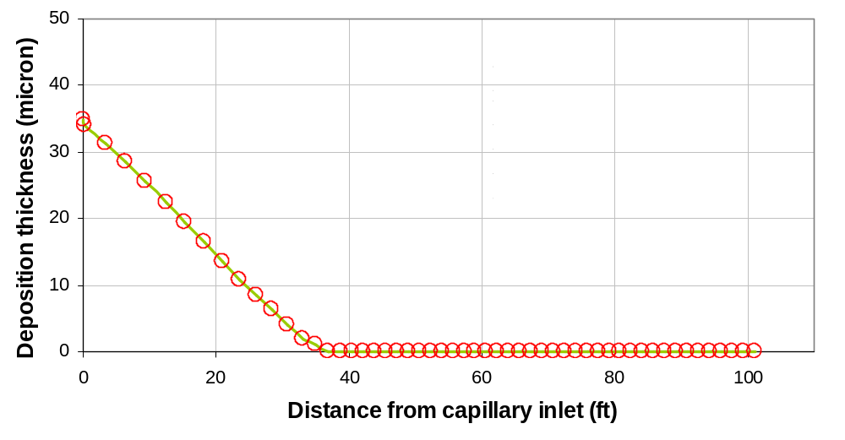
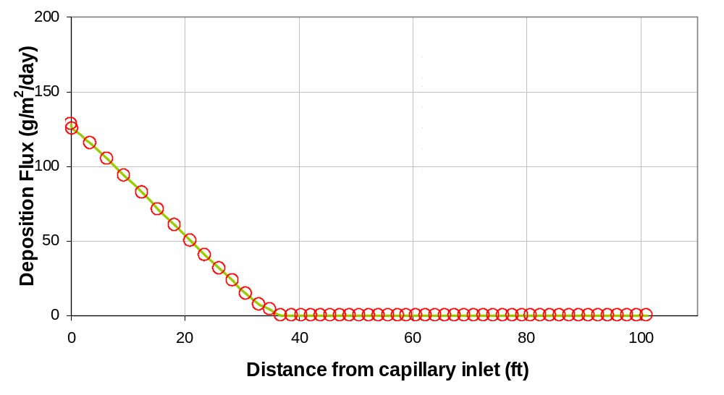
Capillary deposition experiments - NMT
Kinetic parameter estimation
Determination of Kd

Slide 18
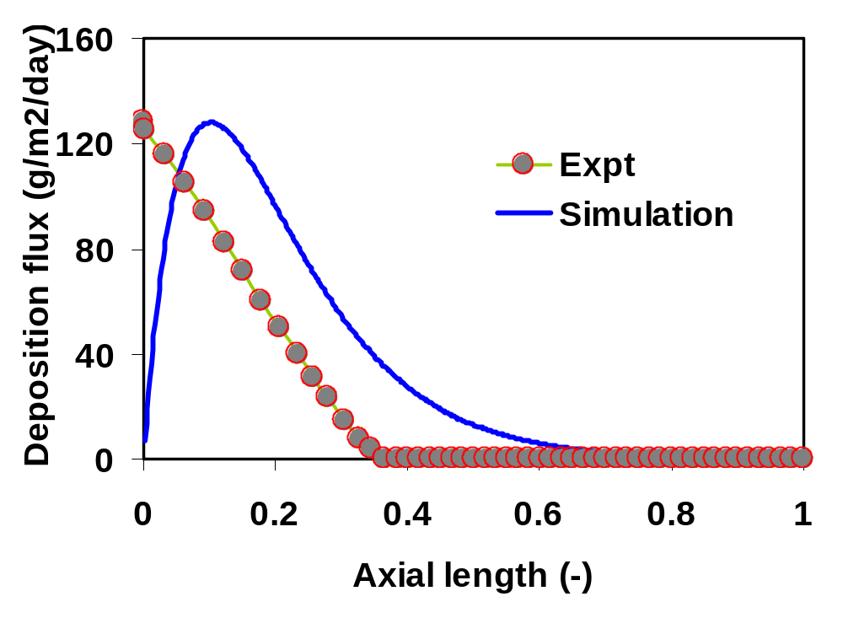
Kinetic parameter estimation, Kd
Simulator predictions for capillary deposition expts
PC SAFT based thermodynamic model was tuned to predict 24 hr onsets with C7.
This model used to predict Ceq with propane.
Kp & Kag determined used.
Kd tuned to match the magnitude of the deposition flux.
Kd = 1.43e-3 /s

Slide 19

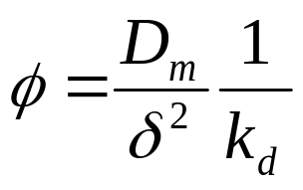
Scaling of Kd from capillary to pipe line
Momentum boundary layer:
δ_{Mom} = 62.7 * Dt * Re^(-7/8)
Mass transfer boundary layer:
Sh = 0.023 * (Re)^0.8 * (Sc)^1/3 (Coulborn analogy)
δ_{mt} = Dt / Sh
- Momentum boundary layer, Laminar sub-layer or mass transfer boundary layer ??
Laminar sub-layer:
δ_{Ls} = 5*y+ ; y+ = γ_{f} / u* ; u* = (τ_{w} /ρ_{f})^0.5

Slide 20
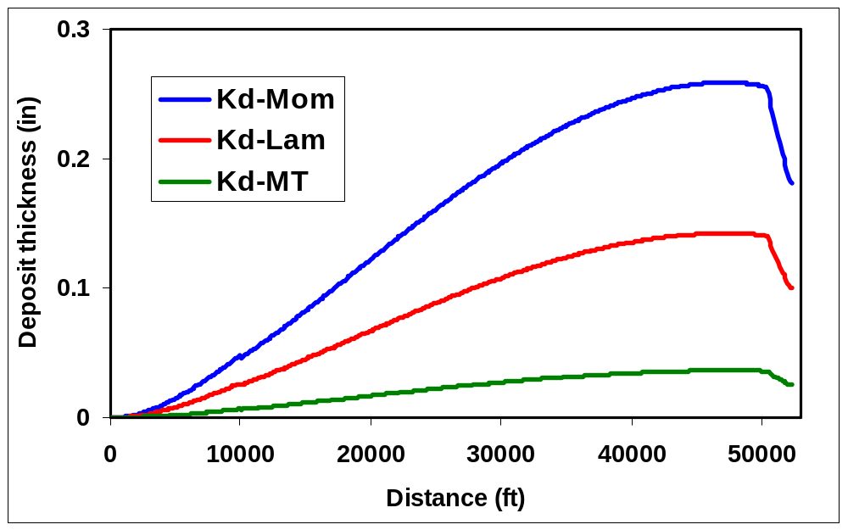
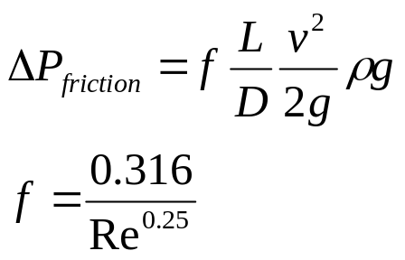
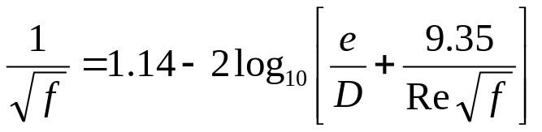
Deposition simulator predictions
Thermodynamic model & P, T profile: Ceq variation along length of pipeline input to the simulator
Simulator predictions: Deposit peak towards the exit of the pipe.
40% asphaltene
Frictional pressure drop measured by Field operators after one month of deposit formation: 648 psi
Darcy- Weisbach formula
Colebrook-White equation
Rough pipes
Hydraulically smooth pipe

Slide 21
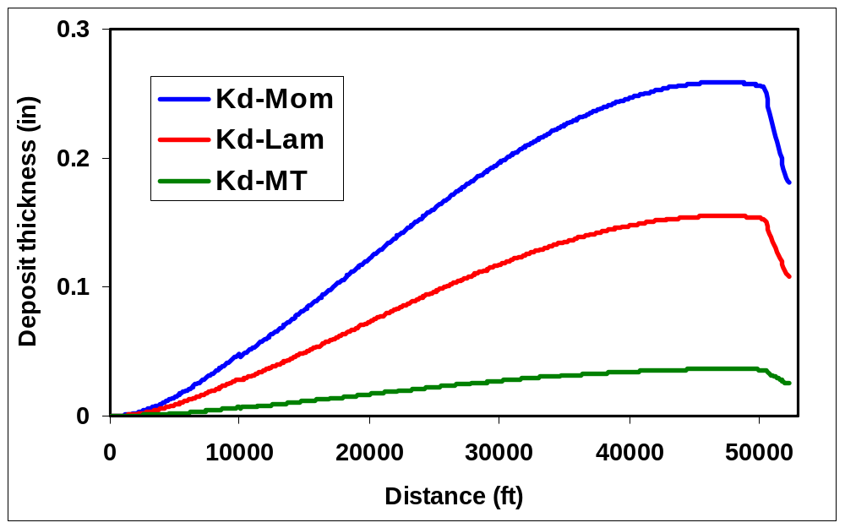
Deposition simulator predictions
Smooth deposit
f= 0.0129
Rough deposit
f=0.018
40% asphaltene
502 psi
700 psi
424 psi
605 psi
372 psi
519 psi
Field measured 28 days Pfric = 648 psi
Frictional pressure loss calculated based on deposit thickness predicted by simulator matches Field measurements.
Simulator predicts maximum constriction near pipe exit. Location was confirmed by Field operators.
First time application of simulator in fully predictive mode. Qualitative & Quantitative match with Field obtained.

Slide 22
Psuedo-transient simulator
Variations of ADEPT
Steady state simulator does not account for effect of growing deposit thickness on deposition rate.
Increasing deposit constriction modifies velocity, pressure and temperature profile – affecting deposition flux.
Psuedo-transient simulator developed that updates changes in
  Pipe ID
  Flow velocity
  Frictional pressure loss.
  Asphaltene solubility based on new pressure profile.
Asphaltene deposition rate very slow hence difference between steady state and pseudo-transient simulator not very significant initially (~ 1 month).
For longer periods of time difference substantially increases. Deposition rate decreases as deposit thickness increases.

Slide 23
Summary
Background
Simulator Structure & Protocol
Deposition Module
Scaling of deposition kinetics
Application of ADEPT to field cases
Variation of ADEPT

Slide 24






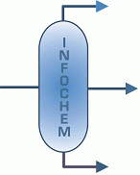

Acknowledgments
DeepStar
Chevron ETC
Schlumberger
New Mexico Tech
Infochem
VLXE

Slide 25
Back up

Slide 26
Modeling of asphaltene deposition
Reservoirs
Heat-exchangers
Well bores / pipelines
In-situ asphaltene precipitation
Continuum models: Surface deposition, pore throat plugging, re-entrainment of deposited solids: Leontaritis 1997, Nghiem & Coombe 1998, Kohse & Nghiem 2004, Wang & Civan 1999, 2001, 2005, Almehaideb 2004.
Particulate simulation: Boek et al., 2008.
Asphaltenes precipitated upstream
Ebert & Panchal 1995: based model Nasr & Givi, 2005 ….
Network model: Radhakrishnan et al., 2007.
CFD simulations with deposit aging: Sileri et al., 2009.
In-situ asphaltene precipitation
Molecular diffusion: Ramirez-Jaramillo et al., 2006.
Semi-empirical model: Jamialahmadi et al., 2009, Soulgani et al., 2009.
Particle transport flux equations: turbulence and diffusion – Eskin et al., 2010, 2011,Johnsen & Johansen, 2009,Escobedo & Mansoori, 1995, 2010.
Continuum model: Vargas et al., 2010
CFD: Ge et al., (to be published)

Slide 27
Modeling of asphaltene deposition
Well bores / pipelines
Ramirez-Jaramillo et al., 2006; Jamialahmadi et al., 2009, Soulgani et al., 2009; Vargas et al., 2010; Eskin et al., 2010, 2011; Johnsen & Johansen, 2009; Escobedo & Mansoori, 1995, 2010; Ge et al., (to be published)
Ignore precipitation kinetics, few consider aggregation kinetics.
Need for qualitative & quantitative comparison of asphaltene deposition profiles.
Goal: Simulator to predict occurrence, location and magnitude of asphaltene deposition along the well bore / pipelines.
Computationally efficient to enable linking with flow simulators (OLGA, PIPESIM, FLOWASTA, etc.) and use for risk evaluation exercises.

Slide 28
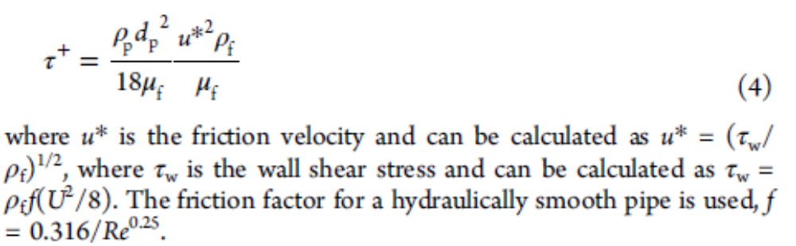
Particle relaxation time

Slide 29
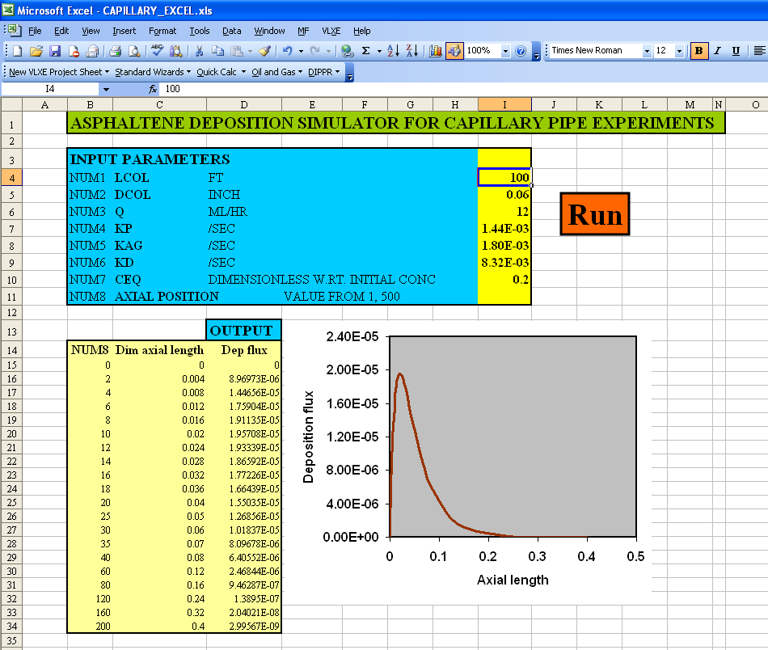
Notes:
We have developed an interface for the easy usage of this tool which is originally a fortran alogorithm. So basically we have built a dynamic link library using the fortran algorithm which is then accessed through Visual basic editor in excel which enables calculation of the deposition profile in excel with respect to changes in these input parameters which are length diameter flow rate and so on..so if we enter the values here and then hit run the dep flux gets updated for diff axial position and this is the plot.

Slide 30
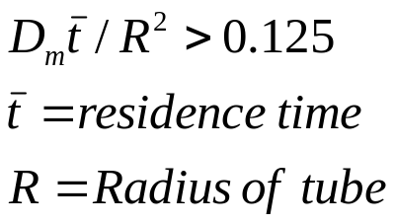
Axial dispersion model
Previous 2-D model – neglected molecular diffusion in the axial direction – axial concentration gradients are much smaller than radial gradients.
Turbulent flow - eddy diffusion due to the fluctuating velocity components dominate molecular diffusion, effective diffusivity is enhanced almost eliminates radial gradients and causes significant mixing in the axial direction.
Correction - add axial diffusion term, equation remains ODE known as axial dispersion model - one dimensional.
At high Re, D depends only on fluctuating velocities in the axial direction that cause mixing. Value of Pe can be determined experimentally using transient experiments with non reactive tracers. Correlation for D exists in literature.
Application of Axial dispersion model – Turbulent pipeline flows
  Laminar pipeline flows – if reactor is so long that
  Initial radial position of a molecule becomes unimportant.
  Vz=0.6, R=0.03, Dm=6E-7, 1.8

Slide 31
Thermodynamic modeling
PC SAFT (Perturbed Chain Statistical Associating Fluid Theory)
Parameters required to characterize each component of the mixture:
Segment size (σ)
Number of segments in a molecule (m)
Segment-segment interaction energy (ε/k)
Chapman et al., 1988, 1990
Molecules modeled as chains of bonded spherical segments
Gross and Sadowski (2001) proposed PC SAFT – successful in predicting phase behavior of large molecular weight fluids – Asphaltene molecules.
Multiflash (Infochem) and VLXE
σ
m
e
ε/k

Slide 32
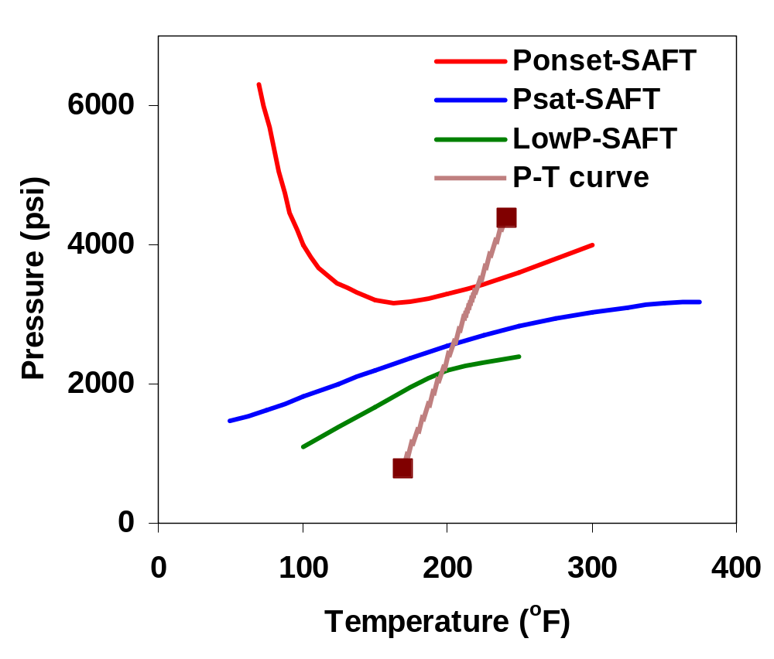
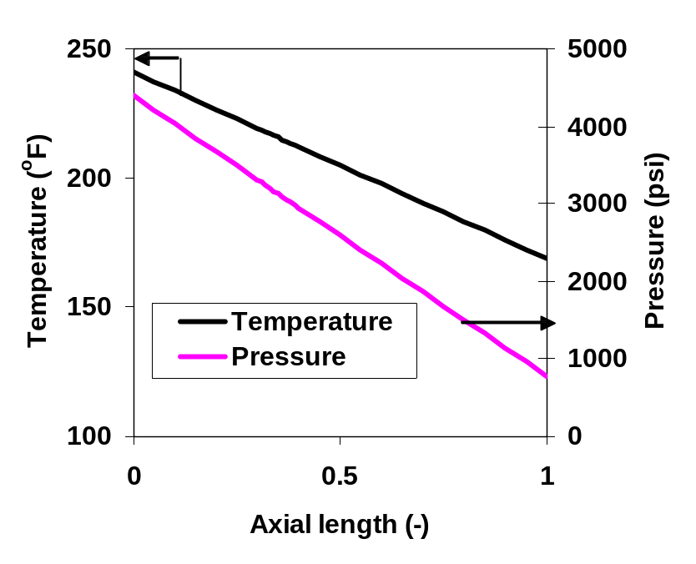
Hassi-Messaoud – Field case 1
Thermodynamic modeling PC SAFT
Live oil composition – Haskett and Tartera (1965), SARA – Minssieux (1997)
Density prediction = 0.8096 g/cm3
Reported = 41.38 = 0.8185 g/cm3
Precipitation envelope
P-T operating condition
Ceq variation along the axial length was computed – input to simulator.
Notes:
With the model being validated for capillary scale experiments we decided to use it to predict field cases. First is the most commonly known Hassi-Messaoud oil wells. We first used PC SAFT EOS to thermodynamically model the oil with oil composition and SARA from these publications and matched the density of the oil we obtained the precipitation envelope of the oil with this oil and with pressure and temperature conditions known along the well bore axial length we can compute the asphaltene sulubility in the oil which goes as an input to the simulator.

Slide 33
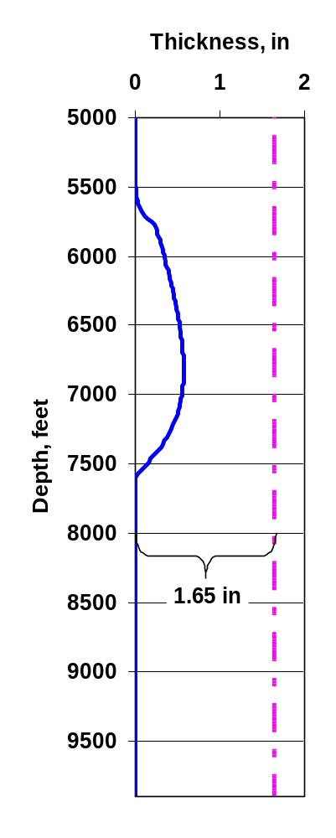
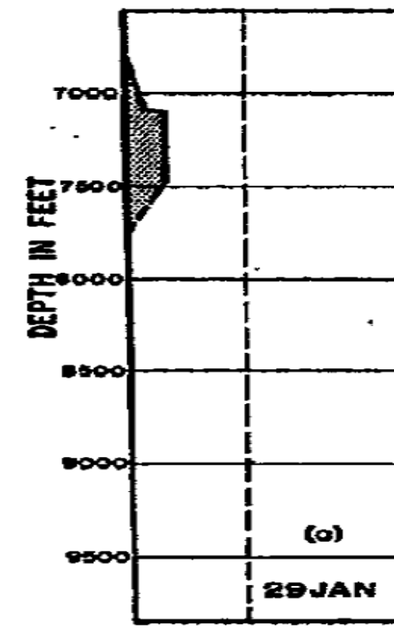
Hassi-Messaoud – Field case 1
Simulator prediction
Simulation parameters
Operating and kinetic parameters
L | 335981 cm | 11000 ft
R | 5.715 cm | 4.5 in dia
VZ, cm/s | 179.36
kA, /sec | 9.05E-03
kD, /sec | 3.92E-03
kP, /sec | 9.05E-02
Asphaltene deposition profile as reported in (Haskett and Tarterra, 1965)
Input from thermodynamic model, duration – 25 days (average of reported time intervals), thickness of deposit matched.
Spread of deposit ~ 2000 ft while reported ~ 1000 ft.
Depends on P-T operating curve - Changes as production continues.
Paper – P-T curve for one well bore while deposit measurements are after the asphaltene mitigation treatment utilized in the paper.
Qualitative and Quantitative agreement
Model prediction
Notes:
This is the reported asphaltene deposition profile in the paper by …this is the depth of the well bore in feet this line has been reported as 1.65 in scale and the deposit thickness therefore is little more than 1/3 rd of 1.65 inch roughly around 0.6 inch. With these operating and kinetic parameters we get this prediction with our model. The duration of the deposit was not very clear so we used an average of the different time intervals that are mentioned between each of these profile measurements which is around 25 days and the thickness of deposit is matched. However, we see that the simulator predicts a much broader deposit spread across 2000 ft compared to the reported trend which is spread probably around 1000 ft. In the paper it was reported that as the well production continues initialy a long thin deposit is formed which spreads around 2000 ft and as the thickness of the deposit increases it acts as a choke to the oil flowing increasing the frictional loss and causing the bubble pressure to go down the depth and making the deposit shorter as it grows thicker due to the modified flow regimes. Since currently we do not consider these effects in the model the simulator predicts the same deposit spread as it what started with. Also pressure temperature data that we are using in the simulator. It is well known that the p-T changes with time as production continues and we do not have information about the PT exactly for this deposit formation. These measurements were taken after the asphaltene mitigation scheme that they have proposed in the paper so may differ. Still we can say that we have a good qualitative and quantitative agreement with what has been reported inspite of all the uncertainties in the data involved.

Slide 34
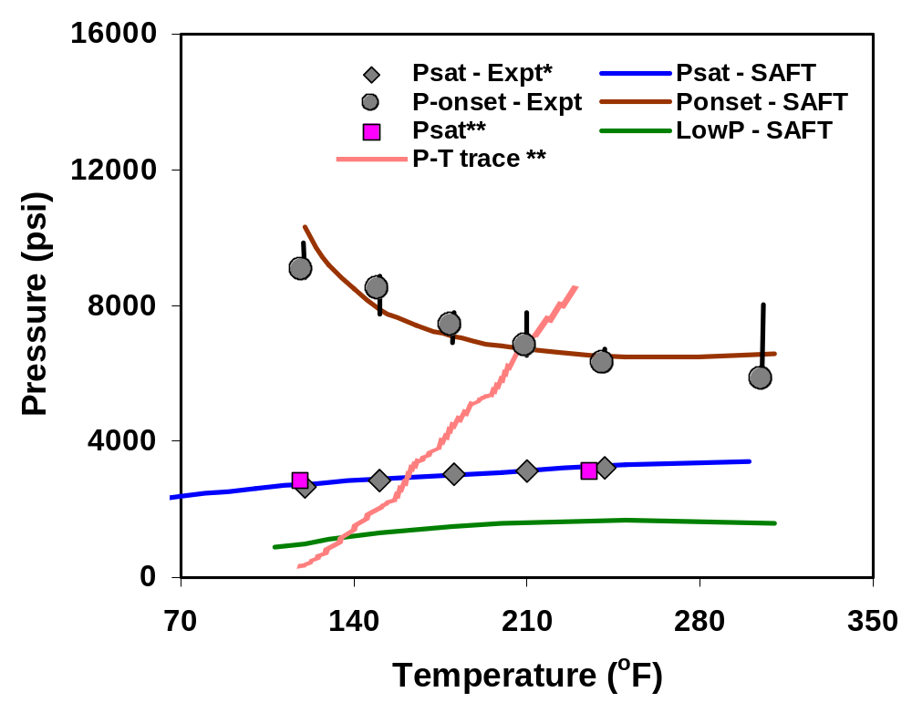
Kuwait Marrat well – Field case 2
Thermodynamic modeling – PC SAFT
API reported* = 36 to 40 PC SAFT = 37. 7
Asphaltene precipitation envelope
SARA - Kabir and Jamaluddin, 1999
Live oil composition, saturation pressure data from Chevron.
PC SAFT thermodynamic characterization.
Calculated Ceq variation along the length of well bore – input to simulator.
*Kabir et al., SPE 71558, 2001
**Data from Chevron
Notes:
That was field case 1 let us see field case 2 which is Kuwaiti marrat oil well for which we have the deposit profile data available. Again like in the previous case we use PC SAFT to thermodynamically model the oil and have matched the density. Dr. Creek provided us with some new data about the live oil composition and saturation pressure of this oil. We used SARA data from one of the publications..this paper also contained onset and saturation pressure data for asphaltenes as shown by these solid points. These data points are the sat pressure from Chevron which match what has been reported in this paper. So we perform the thermodynamic characterization of this oil with this information avaible and these thick solid lines show the predictions of PC SAFT against the expt and their simulation results…. A PT trace for one of the oil well was also provided from Chevron shown by this red curve. With this thermodynamic model and by assuming a linear variation of pressure and temperature along axial length …

Slide 35
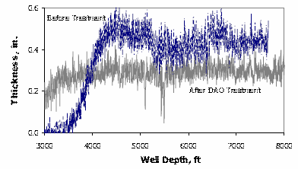
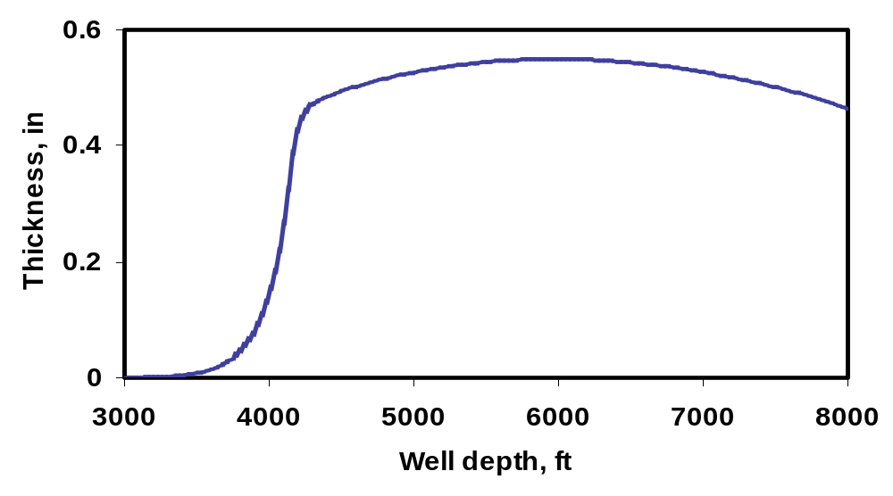
Kuwait Marrat well – Field case 2
Simulator prediction
Operating & kinetic parameters
L, cm | 457200 | 15000 ft
R, cm | 3.49 | 2.5 inch ID
VZ, cm/s | 240.01
k_{A}, /s | 1.81E-03
k_{D}, /s | 7.41E-06
k_{P}, /s | 1.81E-03
Time | 2 months
KD, /s | 1.48E-05 4.81E-06
For 2 months: thickness matched, 1 and 3 month kd changes respectively.
With appropriate choice of dissolution kinetics and other kinetics a good qualitative and quantitative agreement is obtained.
P-T curve with axial length has impact on precipitation start and end zone.
*Kabir et al., SPE 71558, 2001
Notes:
Let us see the simulator predictions. For operating conditions in this table the reported deposition profile is shown in this figure taken from work of Kabir. We are looking at this blue curve shown here. The deposit thickness is around 0.5 inch. With these parameters and for a period of 2 months this is the deposition profile we obtain with the simulator. The time was not given so we assumed two months however for 1 and 3 months the kd changes accordingly to get the same deposition thickness. With appropriate choice of kinetic parameters especially the dissolution rates and if we take the P-T data from Chevron as is we can get this shape of the deposit. The position in terms of depth depends on the PT variation along axial length same like we observed in HM. Our predictions show deposit higher in the well bore compared to what has been reported. By slight variation on pressure vs position data we can match the exact location of what has been reported. Again Pressure temperature data can change as the production continues.

Slide 36
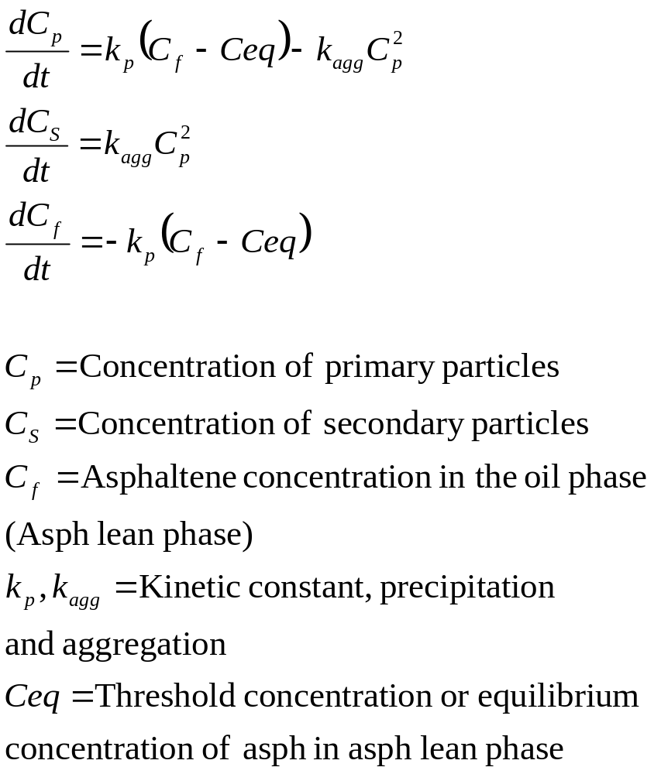
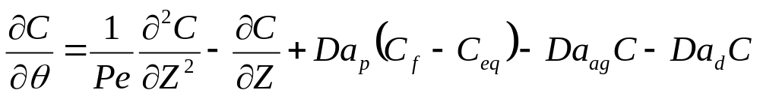
Kinetics model for a batch system
Deposition simulator model
In the expts 0.2 micron filter paper was used to collect aggregated asphaltenes.
We extract the model parameters by matching conc. of secondary particles with the mass collected in the expts.
Hence we assume primary particles – responsible for deposition as particles below 0.2 micron and secondary particles are particles above 0.2 micron.
Notes:
This is the deposition simulator model that we have used so far and this is the precipitation term and this is the aggregation. So we use the concept of generation of primary particles driven by the systems vicinity to thermodynamic equilibrium. Cf is …and Ceq is ..anything above this will start precipitating out with this first order kinetics. Primary particles then aggregate with second order kinetic to form these secondary particles. These primary particles are the particles of our interest that we believe are small enough to fall out of flow and tend to deposit while particles bigger than this get carried by flow. We have not yet determined the size of the particles to discriminate between primary and the secondary particles but as of now we can go ahead with this concept. This is the mass balance for asphaltene in the oil phase. So now we have a model with which if we can determine the constants we can directly use them into our deposition simulator model. These two are ordinary differential equations which can be solved simultaneously either numerically or analytically. Used fortran

Slide 37
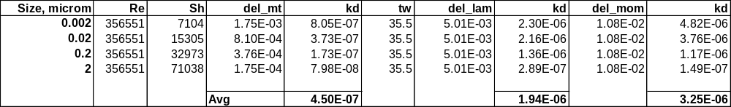
T | deg F | 169
μ | cP | 0.5
ρ | g/ml | 0.7
Dt | in | 4.881
v | cm/s | 184
Re |  | 356551

Slide 38
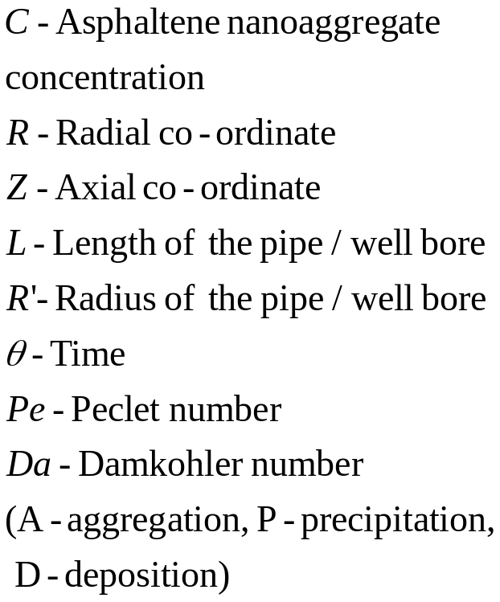
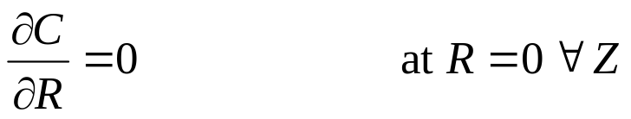

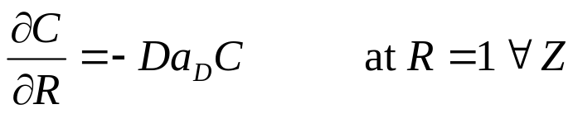

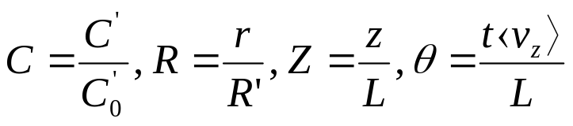
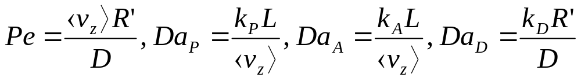
Mathematical model
Boundary conditions
Dimensionless parameters
Vargas et al., 2010

Slide 39
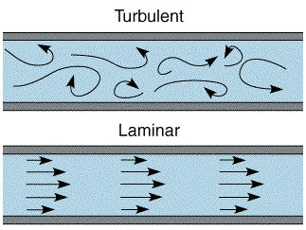
Axial dispersion model
Previous 2-D model – assumes molecular diffusion in axial direction negligible– axial concentration gradients much smaller than radial gradients.
Turbulent flow - Correction - added axial dispersion (D) term, Axial dispersion model - one dimensional.
Pe (D) can be determined experimentally using transient experiments with non reactive tracers. Correlation for D exists in literature.
Laminar
Turbulent
Eddy diffusion dominate molecular diffusion
High axial mixing against radial variation
Application of Axial dispersion model:
  Turbulent pipeline flows
  Laminar pipeline flows – very long (initial radial position of a molecule unimportant).
  Vz=0.6 cm/s, R=0.03 cm, Dm=6E-7 cm2/s, Ratio=1.8
Notes:
The previous model we have seen is a two D model and neglects diffusion in axial direction which is fine for laminar flows however for turbulent flows we have these eddies due to the fluctuating velocity components and the resulting eddy diffusion are much higher in magnitude comp to molecular diffusion enhancing the overall diffusion in the axial direction and causing extensive mixing in the axial direction and hence needs to be accounted for and we need to make a correction by adding this axial dispersion term characterised by this parameter D or the dimesionless pe number which can be determined experiementally there are also several correlations and extensive work has been done to obtain the value of this parameter. This new model called the axial disp model is widely used for turbulent pipelines but can also be used for laminar flows if the pipe is really long such that this condition is met. Where t is residence time . For the capillaries that we use these are the typical conditions and we get a value so we can use this one single model for both capillary and the well bore.

Slide 40
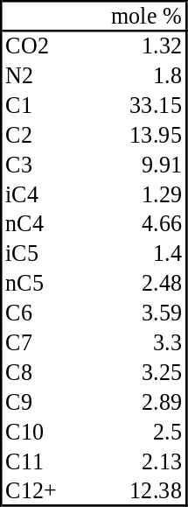
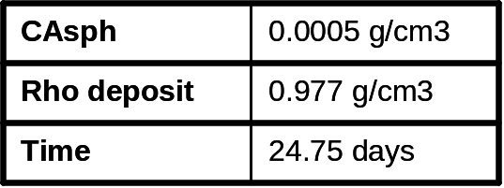
HM
Haskett , 1964
LCOL | 335981 cm | 11000 ft
RCOL | 5.715 cm | 4.5 in dia
VZ, cm/s | 179.36
PE | 301.27
DAG | 16.95
KA, /sec | 9.05E-03
DAD | 7.35
KD, /sec | 3.92E-03
DAP | 169.55
KP, /sec | 9.05E-02
Saturates = 70.5
Aromatics + Resin = 28.8
Asphaltene = 0.195
Minssieux et al. 97

Slide 41
Marrat oil
SATURATES = 68.4 AROMATICS = 11.2 RESINS = 18.4 ASPHALTENE = 2.1
LCOL, cm | 457200 | 15000 ft
RCOL, cm | 3.49 | 2.5 inch ID
PE | 219.46
VZ, cm/s | 240.01
DAG | 3.45
KA, /s | 1.81E-03
DAD | 0.2075
KD, /s | 1.09E-04
DAP | 3.45
KP, /s | 1.81E-03
CAsph | 0.0075 g/cm3
Rho deposit | 0.88 g/cm3
Time | 2 months

